Slide 1


Smart Factories
Prof. Dr. Niko Herakovič
Asst. Prof. Dr. Marko Šimic
Notes:
What Is Industry 4.0 and Smart Manufacturing? 2019 META SMART FACTORY
https://www.youtube.com/watch?v=jQbXZ2_nVok&list=PPSV
Homag Smart Factory
https://www.youtube.com/watch?v=nUXcmQFaNuY
Industry 4.0 - Digital Bosch plant in Blaichach, Germany
https://www.youtube.com/watch?v=m6sl8KMsm5Q
Smart Factory Explainer
https://www.youtube.com/watch?v=fvklxm3X3oE
Audi Smart Factory - Future of Audi Production
https://www.youtube.com/watch?v=sqCbYd8O8MU&t=618s
Smart Factory: 9 Trends Every Manufacturing Organization Needs to Be Ready for
https://www.youtube.com/watch?v=nfuddGc_Hfc
Smart Factory (deutsches Video)
https://www.youtube.com/watch?v=NeC1fOt8bGc

Slide 2
What Is Industry 4.0 and Smart Manufacturing? 2019 META SMART FACTORY
https://www.youtube.com/watch?v=jQbXZ2_nVok

Slide 3
The course Smart factories – basic information and Agenda
Lectures: 30 h
Exercises (Tutorials and Lab): 30 h
Self-learning, independent work: 65 h
Overall: 125 h (5 ECTS)
Programme
Introduction to Industry 4.0 Definition of smart factory concepts Disciplines, systems and technologies for I 4.0 Key approaches to smart factory development Key approaches to smart factory development Referential architectural models of smart factories Smart factory concepts The concept of distributed systems Top-down approach when implementing solutions of I 4.0 Bottom-up approach in implementing solutions of I 4.0 The concept of digital twins (DT) of manufacturing processes of a smart factory Five-dimensional modelling of a DT and its key technologies Control of a smart production with a digital twin Digital twins (DT) and new technologies A smart factory in productronic forming processes
Learning outcomes
Knows and understands: the content and mission of a smart factory compared to traditional factories. The acquired knowledge is used by the student to draft and design processes in smart factories and to integrate them into the whole concept of a smart factory, to make effective use of I 4.0 technologies in a smart factory, and to produce digital twins of processes and the entire smart factory, as well as to control the whole system. To learn about key technologies of I 4.0 and the concept of distributed systems. Knows and understands how to use of tools to evaluate the status of digitization of a traditional factory and computer-aided tools for drafting an efficient smart factory for various purposes. Recognize of the usefulness of I 4.0 technologies in a smart factory. Knows and understands how to use simulation tools for building a digital twin of a smart factory with different subprocesses.

Slide 4
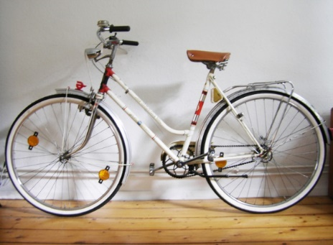
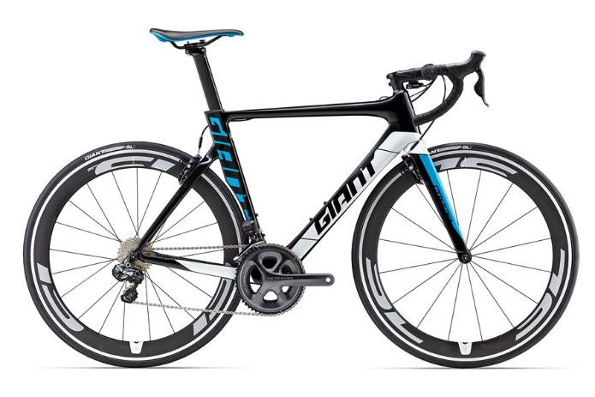
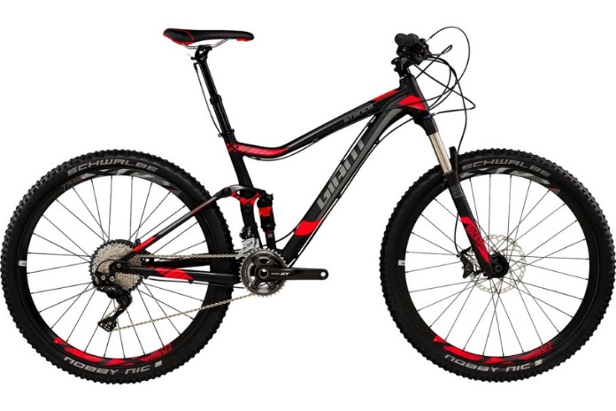
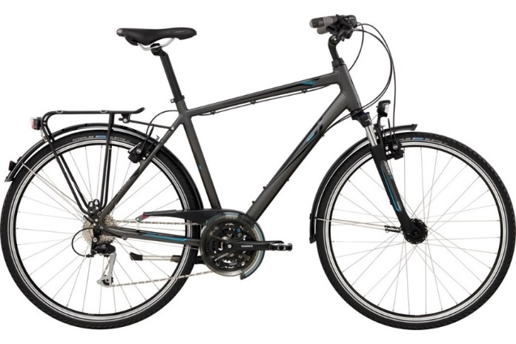
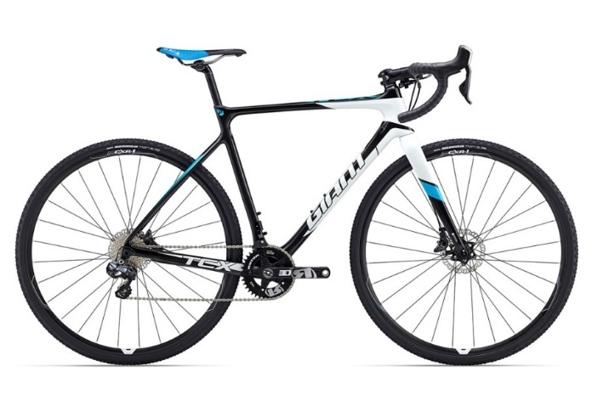

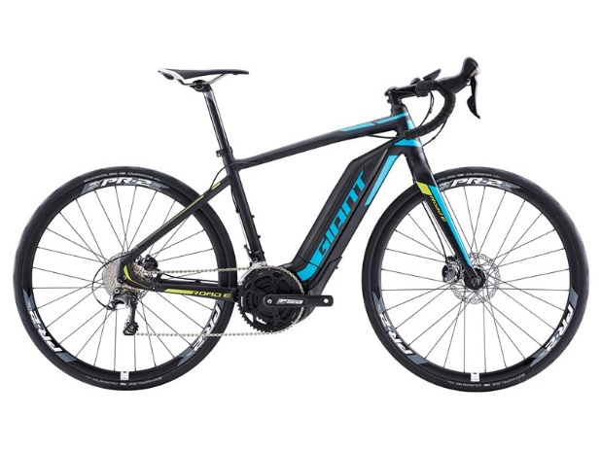
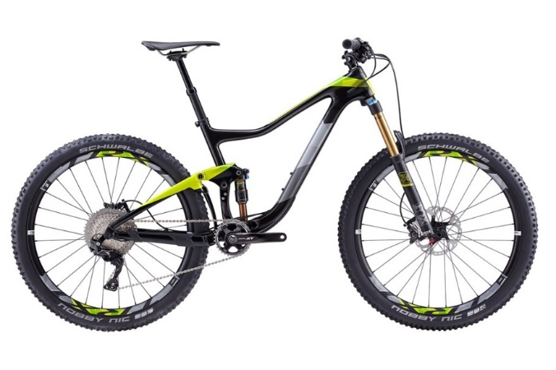
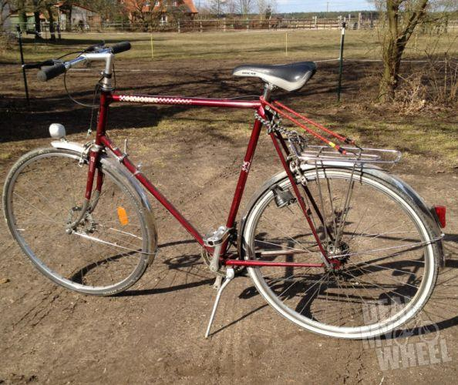
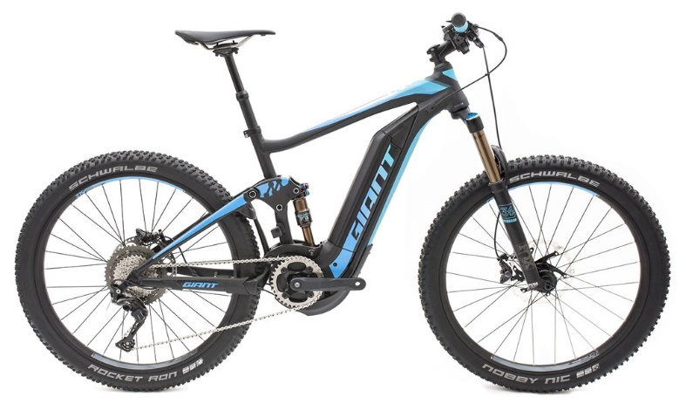
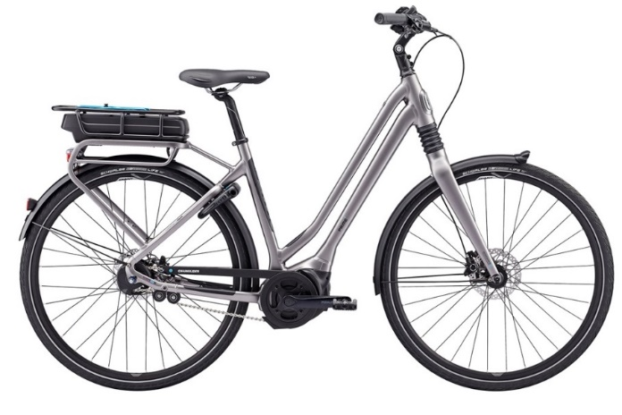
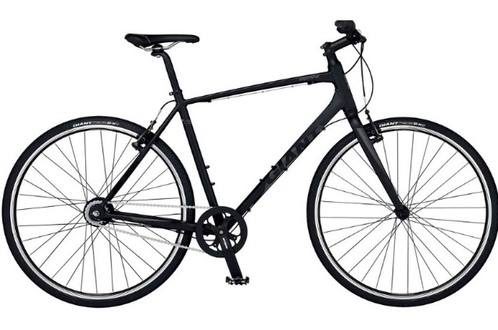
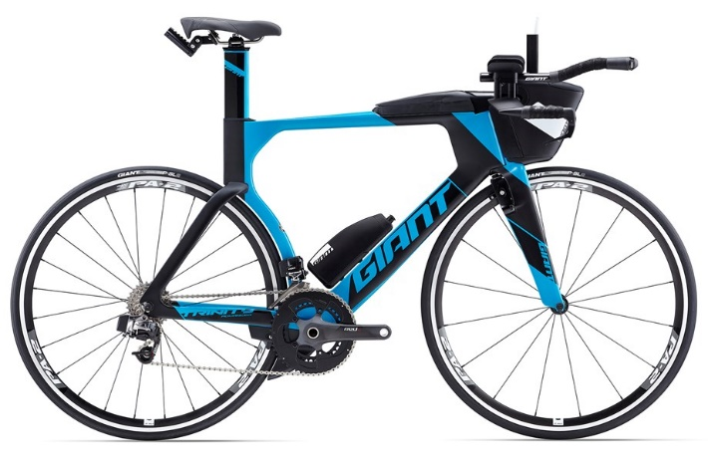
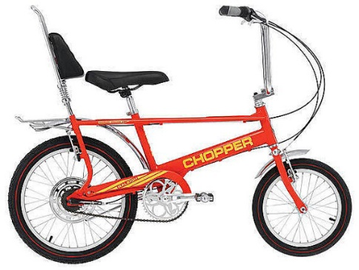
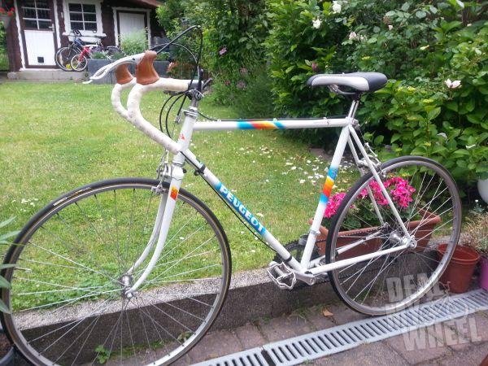
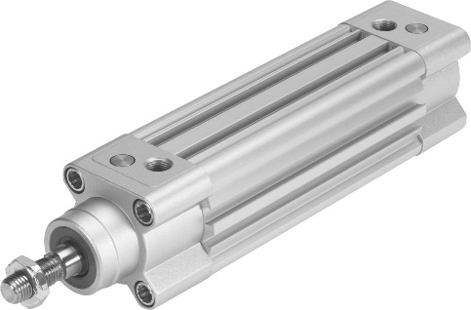
Challenges - Growing customer demands and the number of product variants
Bicycles 1980
Bicycles 2017
Over 63 different bicycles from just one manufacturer, available …
  in different frame sizes,
  in different colours,
  with different forks,
  with different gearshifts,
  with different handlebars,
  with different cranks,
  etc.
A huge amount of product variants must be handled!
Quelle: Giant bicycles
Standard based cylinder DSBC, ISO 15552
Theoretical variance DSBC:
195,360 combinations
plus SA (special applications) and EWK
Important
Source: FESTO
Notes:
What is the main challenge on the market that initiate the idea of Smart factory?

Slide 5
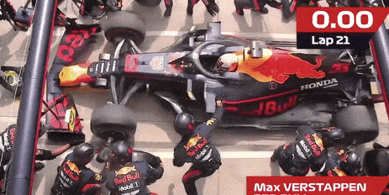




RAPIDITY / SPEED
1.82 s
Max Verstappen, Red Bull
What is the world record at the F1 wheel exchange?
Important
Notes:
What means Agile?

Slide 6
T. Ohno: “Shortening lead time by eliminating waste”
Exp: Sit on one kg of incoming material and observe what happens….
VA: Cutting, Sewing, Welding, Stapling, Gluing,…
NVA: Transporting, Storing, WIP, Walking, Waiting, Overproduction, Overprocessing, Reworks, Scrapping, Ignoring ideas, Repeating mistakes, Wrong product, place, quantity, Uncoordinated activities, Checking, Tool changes, Urgent actions, Firefighting, ….
Focus of traditional improvements: Reduce cycle time, Work harder, Add people, Add equipment….
Eliminating waste is the focus for a lean deployment!
VA 5 to 10 %
NVA: Waste!
> 90%
Important
Notes:
What is the main goal using the new approaches in Smart factory?
To reduce the NVA, with other words to eliminate waste from the process. And this is also the goal when implementing LEAN strategy first and then with implementig digitalization. To reduce the constant work in progress, to make process more transparent that we are able to discover new opportunities for improvements, data, visualization, highlights and findings, evaluation of the processes.

Slide 7

Introduction to I4.0 (4th Industrial Revolution)
The term »Revolution« determines rapid and radical changes
Industrial revolution is defined as the major rapid changes and transition in manufacturing and industrial processes with new innovative technologies.

Slide 8
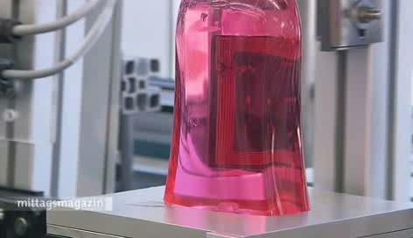
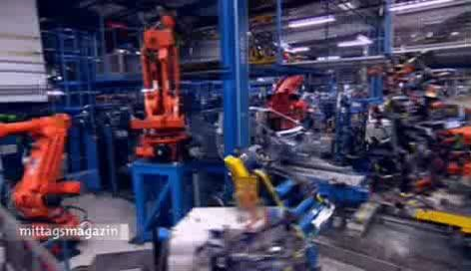

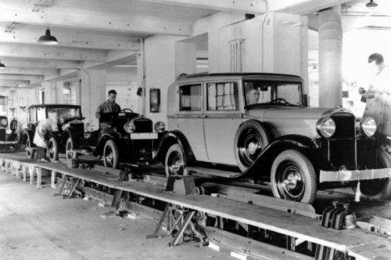
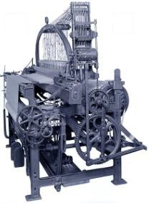






From Industry 1.0 to Industry 4.0: Towards 4th Industrial Revolution
Source: Pino Zani, 2013, Zühlke, Smart Factory
4th Industrial revolution CPS, IoT, IIoT, AI, Big data
Level of complexity
010001101
001010100
100101010
010010101
Industry 4.0
3rd Industrial revolution
Use of IT and electronics, industrial robotics, automatization of production
Industry 3.0
2nd Industrial revolution
Mass production
enabled by division
of labour and electricity
Industry 2.0
1st Industrial revolution mechanical production based on water and steam power
Industry 1.0
Important
End of
18th century
Begin of
20th century
Begin of
70s
Today -> Furure
Time
Notes:
What is Industry 4.0, the main trends. Integration of I4.0 is the base for the Smart factories, so the SF relays on this technologies. Involvement of human resources, working togehter with machines, HMI, CPS.

Slide 9
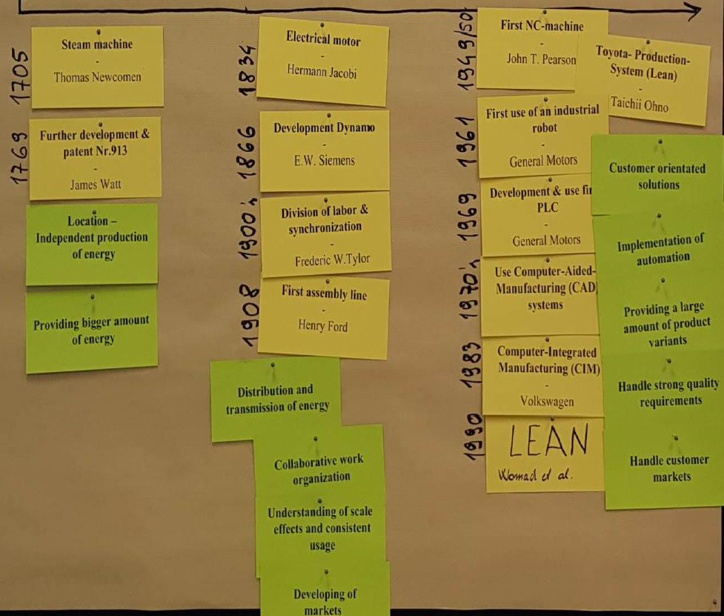
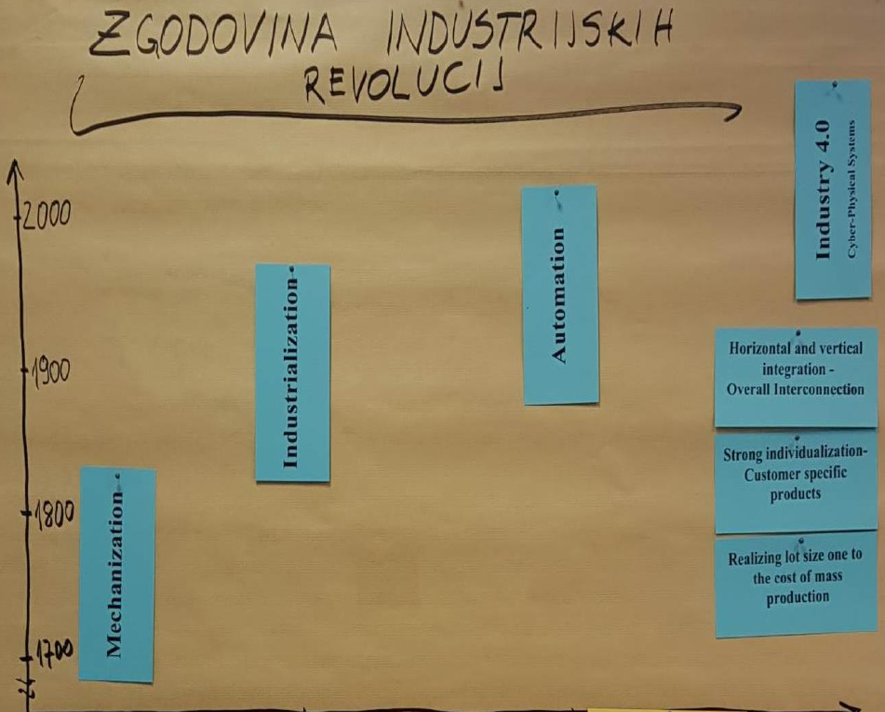





Industry revolution – short overview, essential message
Notes:
Focus on organizational part of factories.

Slide 10
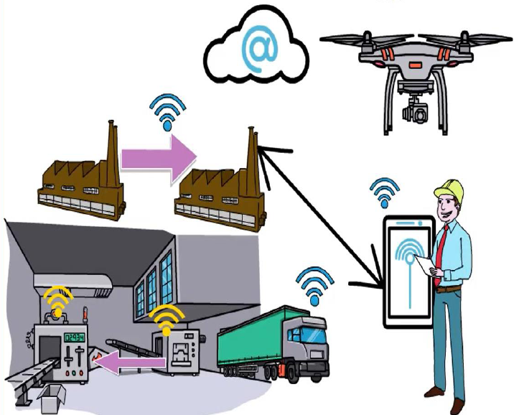

WHAT IS INDUSTRY 4.0?
"Industry 4.0 is a new phase in the Industrial Revolution that introduce intelligent networking of machines and processes for industry with the help of information and communication technology"
It connects physical world
with
digital world
Important
Technology In Short

Slide 11
The double attractiveness of the 4th Industrial Revolution
The industrial revolution is, for the first time in history, happening with an advance prediction - this gives the opportunity for companies and research organizations (and all of us) to actively co-shape the future.
Its economic impact should be exceptional:
  a significant increase in operational efficiency
  development of new business models, services and products.

Slide 12


Industry 4.0 and SMLC
Industry 4.0 - German State Initiative - beginning 2010, first publicly announced in 2011. Supported by the EU -> becoming an EU-level initiative.
SMLC - the USA initiative - Smart Manufacturing Leadership Coalition (SMLC) is an initiative by enterprises (multinationals) - supported by the state.
    Both initiatives are complementary !!

Slide 13
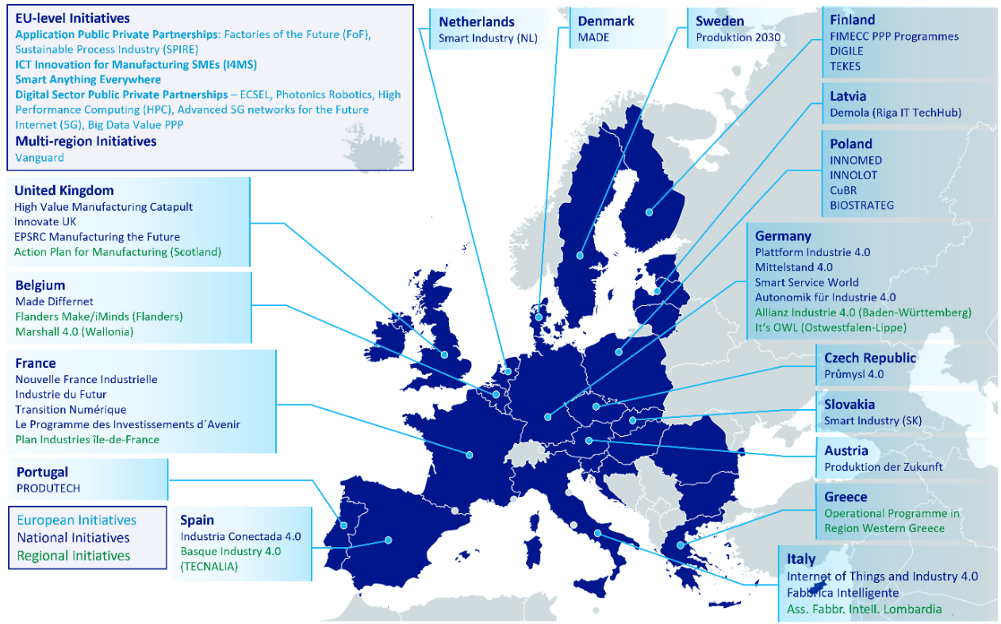
EU Initiatives
Smart4Europe2, Catalysing Digitisation throughout Europe

Slide 14
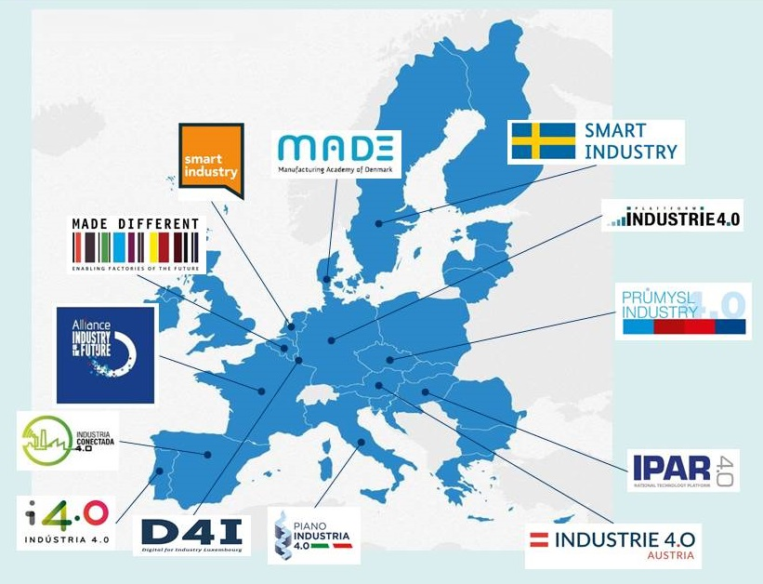

EU frameworks and competence centres
Factsheet / infographic | Publication 19 April 2016
https://www.effra.eu/

Slide 15
The tools and approaches to strengthen the competence of enterprises
Integration of the Internet of Things (IoT) into the production process.
IoT enables communication between individual objects (machines, devices, products, etc.) with the help of technologies such as RFID, various sensors, machine vision, actuators, etc.
CPS (Cyber-Physical Systems) - the integration of virtual and physical processes.
Embedded computers and networks control and control physical processes and at the same time affect one another.
Important

Slide 16
Concequences for companies…
Companies face difficulties when identifying and implementing scenarios of Industry 4.0.
We have to know what to do in general and what to do first (the sequence of activities) to achieve major effect.

Slide 17

Some goals in the companies we are pursuing...
Increasing the efficiency, availability and reliability of production, logistics processes, etc.)
Increasing productivity and competitiveness (OEE, ...)
Shortening of throughput times and delivery times (time to market)
Reduction of stocks and inventory
Minimizing errors, distractions and discards (waste)
Individualization of products, flexibility, agility,...
Reducing energy consumption, less carbon footprint...
NO !!!
Do these goals change in I 4.0?
Notes:
What the companies are looking for, their goals, what to improve withing the processes?

Slide 18






Different approaches to solve the challanges…
Supply Chain Management (SCM)
Total Quality Management (TQM)
Time Based Competition (TBC)
Business Process Reengineering (BPR)
Theory of Constraints (TOC)
Quick Response Manufacturing (QRM)
Lean, Lean Thinking
Agile Manufacturing (AgileM)
Digitalization (digital LEAN, I4.0 Techniologies, Smart Factory…)
Notes:
Some of the solutions how to overcome problems, what to implement.

Slide 19



The Evolution of Industrial research – Perspectives of Future Production
Vision of
Manufacturing
2030
PERSPECTIVE
Remote Factory
Virtual-Real Work
Virtual Factory
Process Models
System Models
Simulation Technology
Remote Services
Digital Manufacturing
Digital products
Digital Factory
Life Cycle Management
High Performance
Beyond LEAN
Phase 2:
Adaptive Manufacturing
Synergetic networking
Factory of the Future
Phase 1:
„As – is“ –
State of the art
„LEAN“
New Paradigm -
MANUFUTURE VISION
Source: Several Sources, 2015

Slide 20
Industry 4.0 and jobs
Industry 4.0 is an industrial ecosystem, which requires, among other things, a change in the role of people in the industrial value chain.
The good news is that when introducing a new company paradigm, it is crucial that workers develop new skills and introduce new tools to be able to deploy Industry 4.0 in the right way.
Despite some weaknesses, the risks that Industry 4.0 brings, gives us the opportunity to keep creating value in the industry in Europe, even where it was not possible to do so.

Slide 21
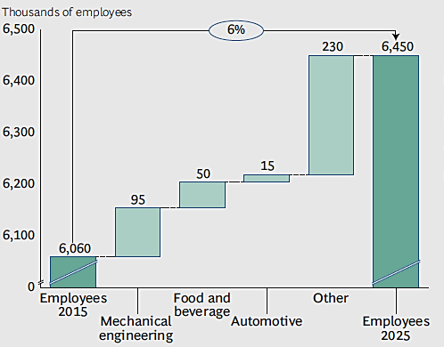
The development of worker needs in Germany by 2025
Source: German Federal Statistical Office
Different skills and knowledge of workers will be required!
Notes:
Humans are important to understand the industry 4.0. The skills, competences of people, workers.

Slide 22
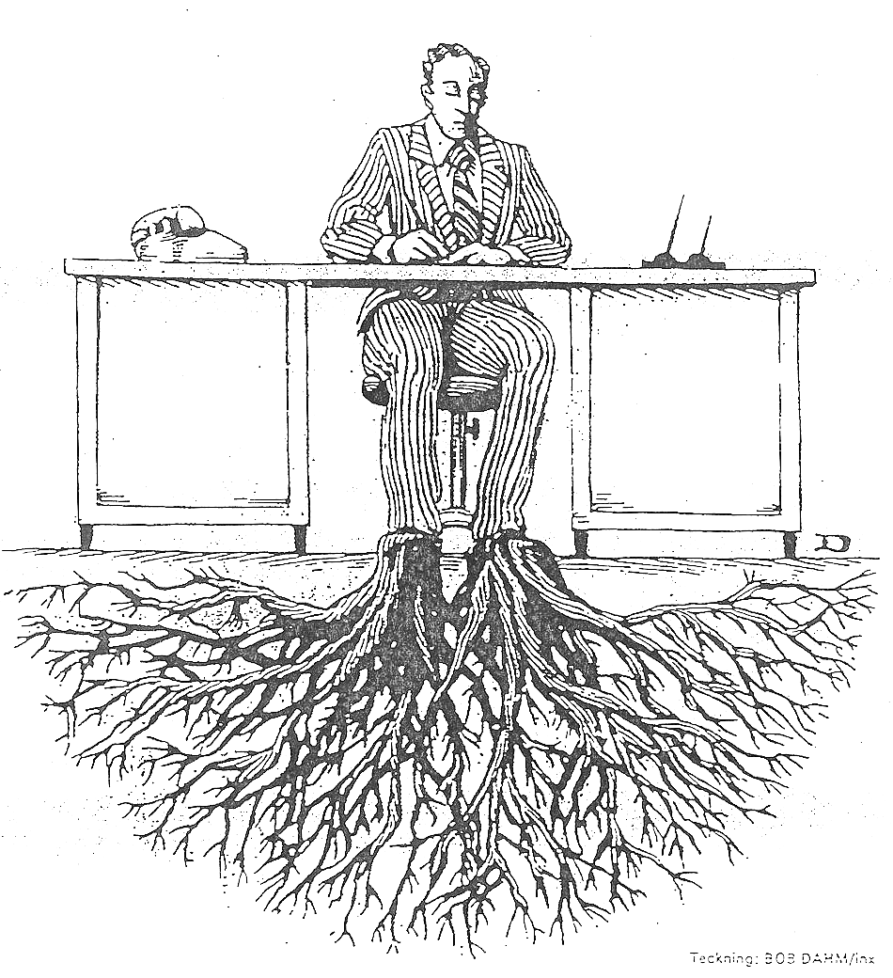
Changing of people is …
Source: Bob Dahm/inx
German proverb
"It is not the great who will eat the small, but the quick who will eat the slow"
Heinz Peter Halek

Slide 23
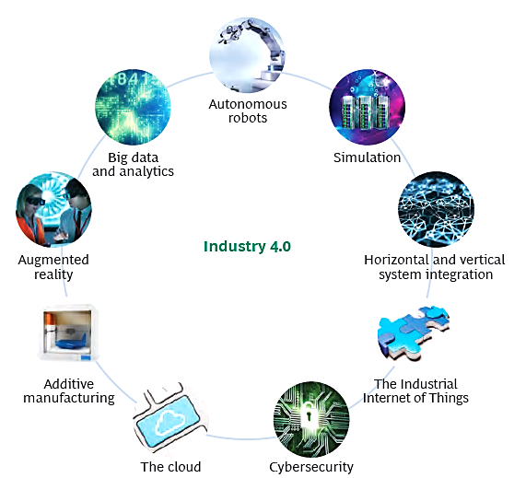



Nine main pillars of technologies for I 4.0
Important
Source: BCG

Slide 24
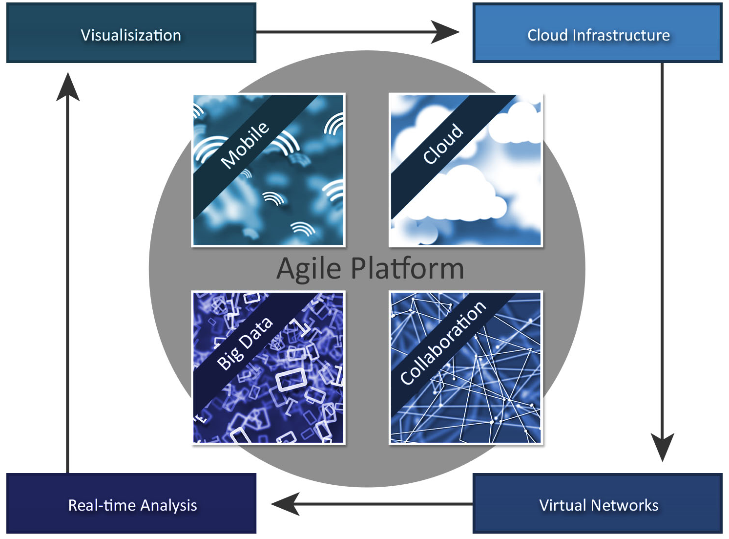







Components of Industry 4.0
Important
Source: Goodarz, Axxessio GmbH

Slide 25


The second component of Industry 4.0: CLOUD
Around 70% of adult Internet users in the USA use personal services of CLOUD
Cloud will replace PCs
SECURITY???
Important
Source: Goodarz, Axxessio GmbH

Slide 26
The third component of I 4.0: Cooperation and Virtual networks
Important
Transformation of cooperation
  Cyber-physical production systems
The connection between virtual and real world
  Processes
  Embedded systems
  Software components, integrated into machines
  Robots do not receive commands from the central computer but from the product
Source: Goodarz, Axxessio GmbH

Slide 27
The third component of I 4.0: Cooperation and Virtual networks
Important
How it works?
  Through RFID (Radio-Frequency-Identification)
  NFC (Near-Field-Communication)
  QR (Quick-Response-Code)
Benefits of Smart Factory Technology:
  Components can be provided by different manufacturers
  All components communicate using the same language
  Production starts only when the command comes in
  The buyer is always informed about the development
  A precise number of products in the production process
Source: Goodarz, Axxessio GmbH

Slide 28

The third component of I 4.0: Cooperation and Virtual networks
Challenges:
  Moving from a centralized to a decentralized production control system – even better to distributed control system
  Security (DATA, Information, Systems etc.)
How the revolution will start or is starting?
  Without „Big Bang“
Important
Source: Goodarz, Axxessio GmbH

Slide 29

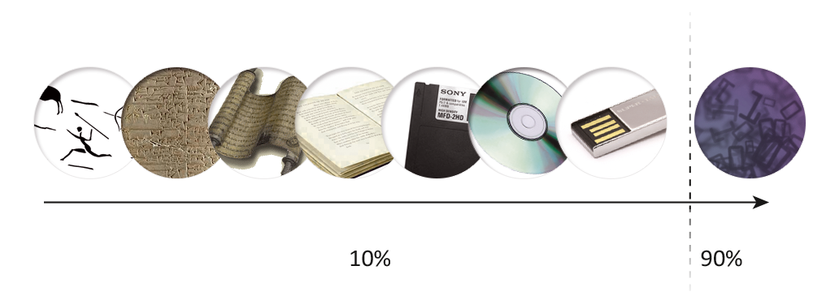
The fourth component of I 4.0 – Big DATA
Data is generated everywhere
According to information from IBM
2.5 – 3 exabytov / day
1 exabyte = 1.000.000.000.000.000.000 bytes
90% of all data was produced in last TWO years letih.
Important
Source: Goodarz, Axxessio GmbH

Slide 30
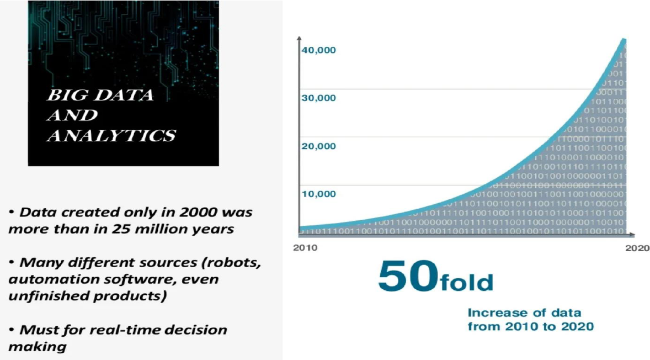
The fourth component of I 4.0 – Big DATA and analytics

Slide 31
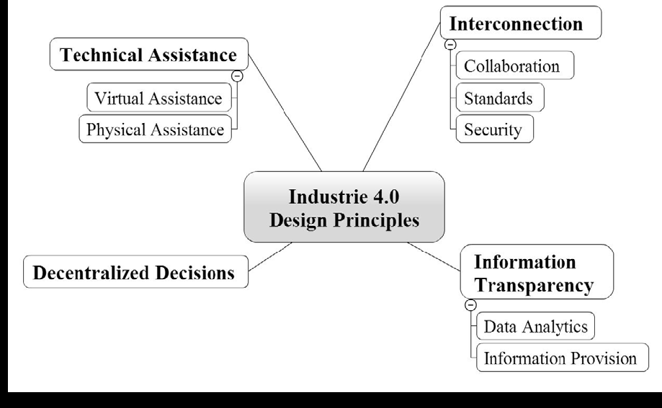
Four main principles of introducing of Industry 4.0 – „How to do“ principles
Source: IEEE
Notes:
Tukaj ostal dne 4.10.2023

Slide 32


What will be for the factory of the future very important?
Important
Software and smart algorithms (AI) for data analysis in real time, provides data in a comprehensible form or format and which will work easily and safely.
Workers with different skills, open to new technologies and adaptable to rapid changes. In spite of all the progress, man will still be a decisive factor that will properly interpret the events, react and appropriately decide quickly.
Highly skilled workers with multiple competencies and abilities to reasonably analyse various information for meaningful future use.

Slide 33

Steps of production companies in active transformation towards the Smart Factory
Important
Identification of key areas for improvements:
  flexibility,
  speed,
  productivity,
  quality.
Consideration about the use of nine pillars of technologies of I 4.0 in a way, that the improvements of the above mentioned fields will be possible.
Avoid the situations when we could stack at the level of incremental approaches --> consider basic changes by using 9 (and more) pillars of I 4.0 technologies.

Slide 34

Steps of production companies in active transformation towards the Smart Factory
Important
Analysis of the long-term impact of the deployment of new I4.0 technologies on the workforce and the introduction of strategic planning for the workforce.
Adjusting of workers to new roles, recruiting new, capable workers, and introducing additional training to acquire additional IT skills which will be needed.

Slide 35
Other necessary measures
Development of knowledge for the use of new technologies in order to achieve the highest impact.
Participation in the design of new technological standardization.
Development of the vision of the long-term evolution of the industry and the preparation of our own strategy.
Upgrading of the appropriate technological infrastructure, which will enable data transmission in real time.
Adaptation of trainings.

Slide 36
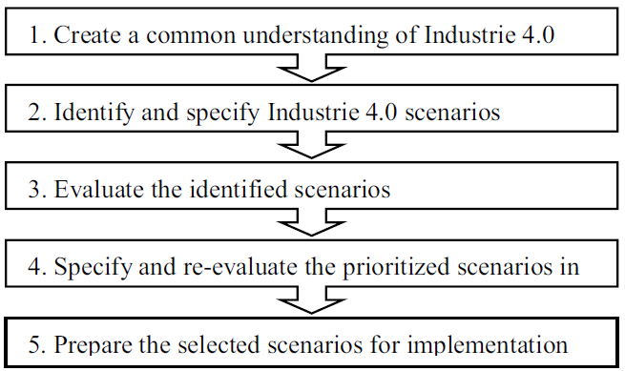
Plan of the implementation of the I 4.0 project in the company

Slide 37
What can slow deployment Industries 4.0?
A serious problem – the advantage of the USA in the IT field (the most innovative IT companies are in the USA) → for now, the only way to overcome this problem is cooperation with US IT companies → here the problem of data security and trust (CyberSecurity) appears.
Lack of "Smart" people.
Significant inertial forces that, internationally speaking, keep traditional production stable as much as possible with only incremental improvements towards Industry 4.0
What is the potential problems?
Notes:
What is the potential problems?

Slide 38

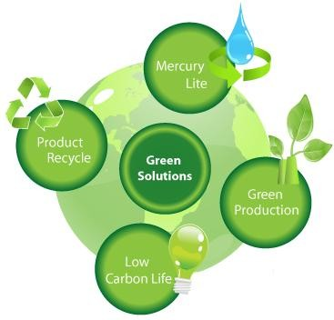

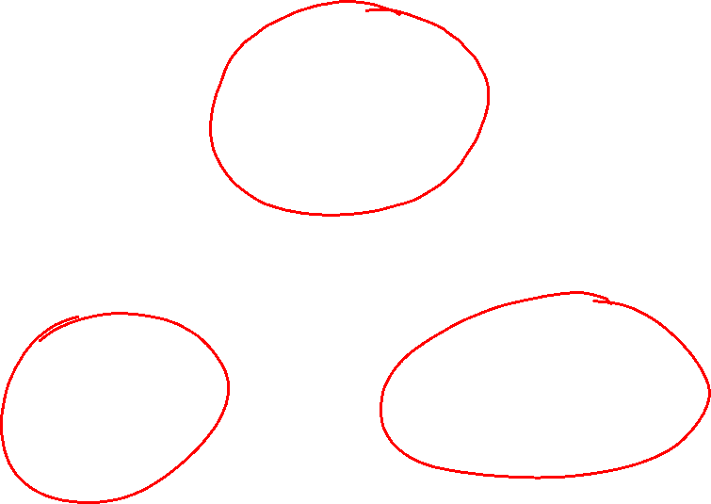
Industry 4.0: Smart, Green and Urban production
Important
Holistic approach
Smart production
High-precision, high-quality production of diverse and small-batched smart products
Green production
Clean, Energy efficient and Sustainable
Urban production
Smart factories in the cities, close to workers homes
Notes:
It is not only about the production, production improvements but also the impact of production on environment, the factory placed in the local environment, the sustainability the green production effecting the carbon emission, environment footprint.

Slide 39
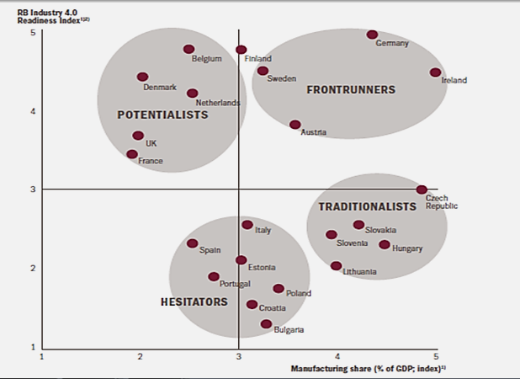

Potencial of Industry 4.0
Source: Salminen, Hermia Group

Slide 40
Expected profitability of European industry
Return on Capital Employed
Source: Blanchet, Rinn, von Thade & De Thieulloy, 2014
Notes:
ROCE - Return on Capital Employed

Slide 41
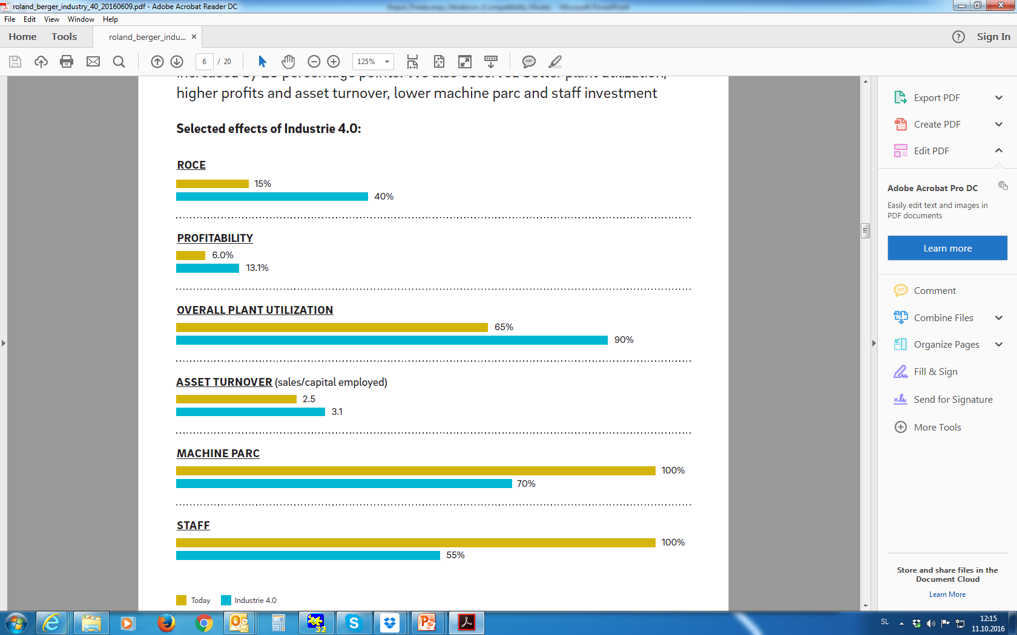
Forecast effects of industry 4.0
Return on Capital Employed
Source: Roland Berger
Notes:
ROCE - Return on Capital Employed

Slide 42
Three "enablers" of the factory of the future
Important
Strategy and leadership
Adequate IT infrastructure
  The IT infrastructure must enable connectivity throughout the value chain
  It must ensure data security
Skills and competencies of workers
Source: WZL, RWTH Aachen, 2017

Slide 43
Competences of workers in the factory of the future
Technical competences - greater emphasis on competences in the fields of ICT, electronics, mechatronics, cyber systems (feedback-loop control)
Social competences (ability to learn, teamwork, responsibility, ability to solve problems).
Education and qualifications
Technology-supported learning (working at the workplace with appropriate self-learning programs on mobile devices - not learning via PPT presentations in the classroom)
Source: WZL, RWTH Aachen, 2017

Slide 44
SMART FACTORY

Slide 45
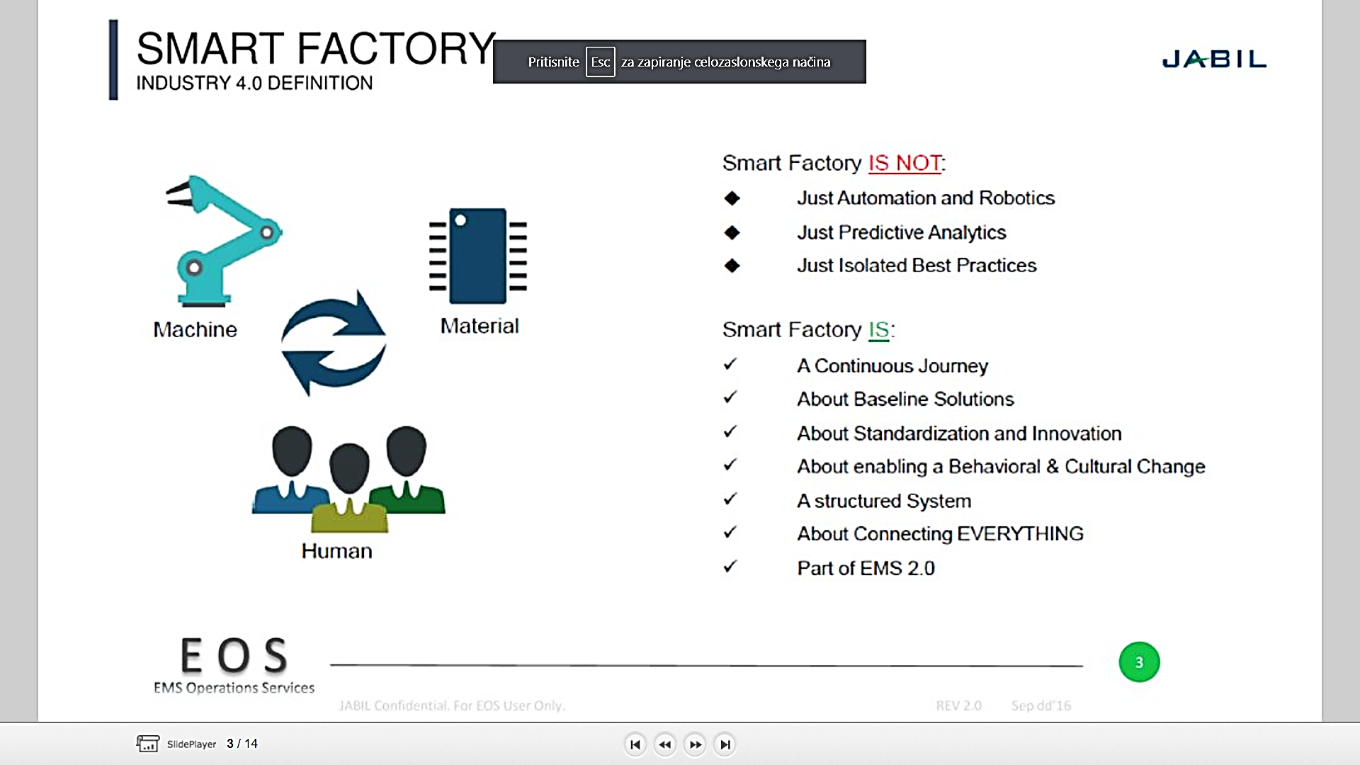

Smart factory - definition
Important
Source: EOS, EMS Operations Services
Notes:
EMS – Energy Management System
https://slideplayer.com/slide/15935556/

Slide 46
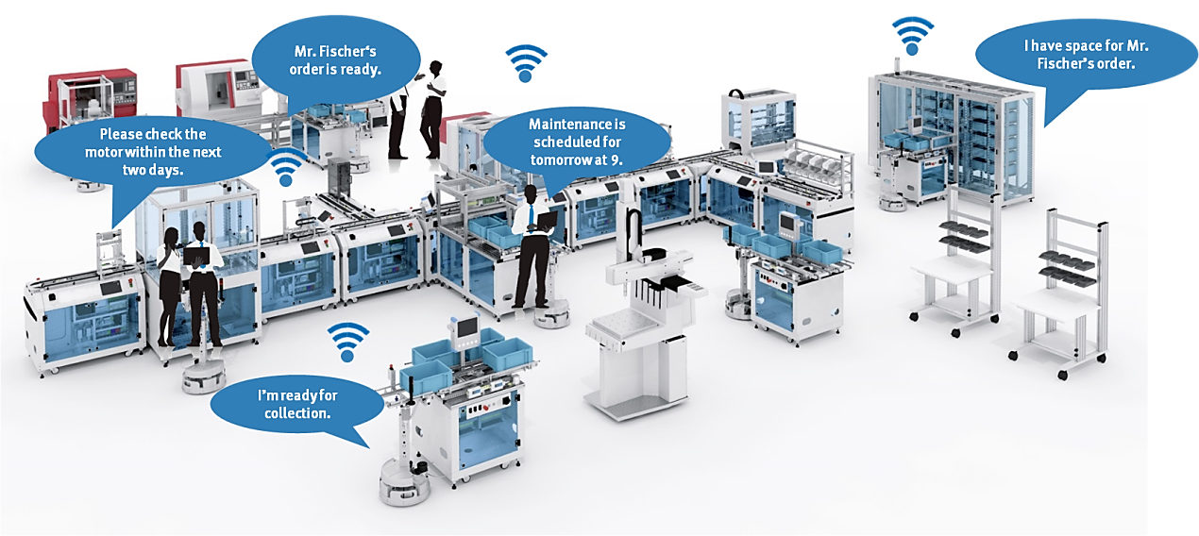
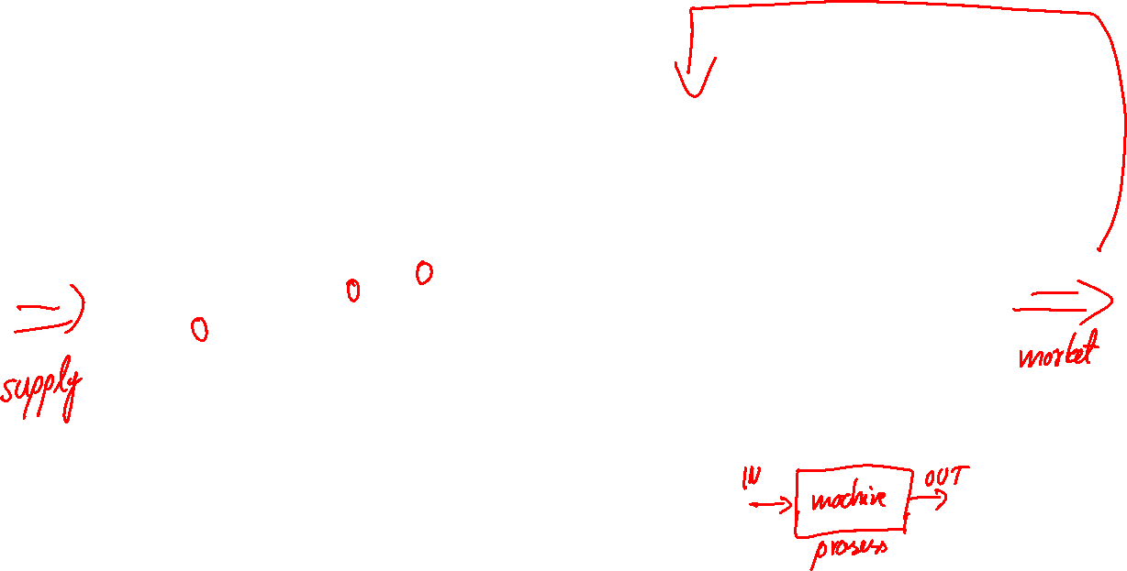
Smart factory
Important

Slide 47
Smart manufacturing ecosystem

Slide 48
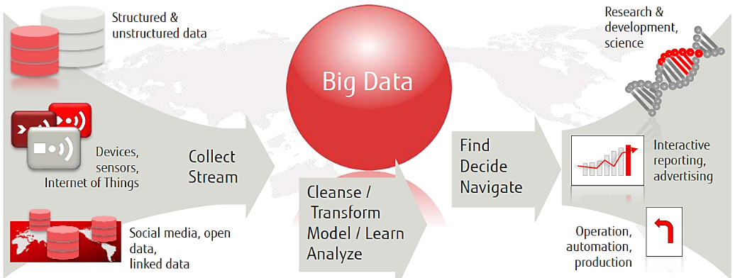
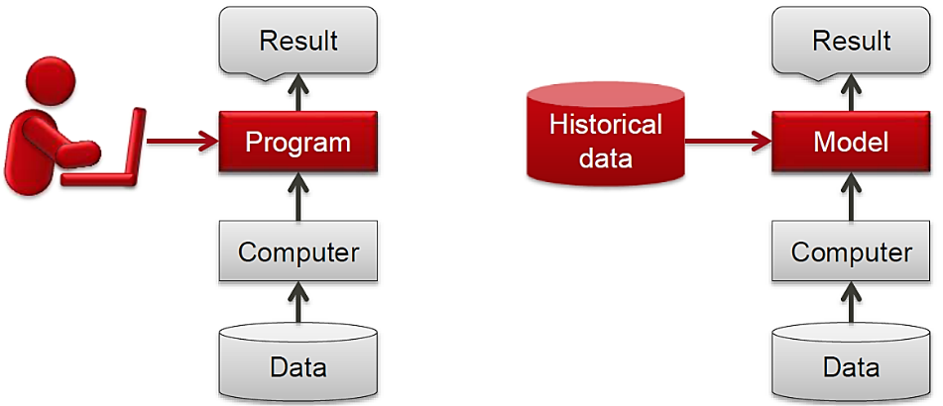
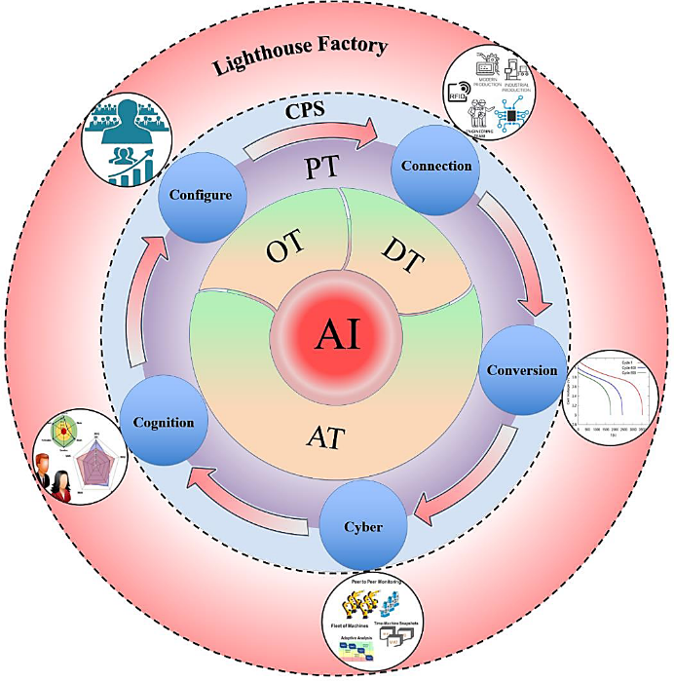

Challenges of Smart value chains
Big data in Smart factory
Machine learning instead of programming
Smart factory with integrated AI.
Important
Lighthouse factories worldwide:
Foxconn Shenzhen, Bosch Automation, BMW, Tata Steel, Procter & Gamble, Rold
Source: FUJITSU
Source: Jay Lee, Jaskaran Singh, Moslem Azamfar, Industrial Artificial Intelligence

Slide 49

The essence of the Smart Factory vision
Important
It is a factory that helps people and machines-devices to perform tasks with the help of systems that work in the background.
These systems perform their tasks on the basis of information obtained from the physical (process parameters) and virtual world (simulation models, decision agents, documents in electronic form, etc.).
Based on the IoE (Internet of Everything - IoT + IoP), the smart factory enables the connection of people, things and data → a new way of organizing and managing industrial processes.

Slide 50
Seven steps towards the Smart Factory
Important
Bring people who know what I4.0 technologies enable for a common table - an interdisciplinary team.
Find a common language - due to a lot of terms, technologies, areas, etc. the "Babylonian linguistic confusion" can arise. Therefore, we need to focus on the actual problems which we want to solve and leave out the technological or business jargon.
Define business objectives - do not get lost in technological details. Eg: What can we do to make our customer more satisfied? Does more flexibility help us to sell? etc.
Define the ideal business goal. Eg: Shorter lead time from product design to delivery!
Notes:
Important from practical point of view, practical implementation.

Slide 51
Seven steps towards the Smart Factory
Important
Estimate the costs and benefits and develop an investment plan!
Defining technologies that can enable us to achieve our goal according to the estimated costs and benefits - using steps 1 to 5, we can usually solve a large part of the task, and at the same time identify the technologies and areas, which are missing.
Implementation and continual improvements.

Slide 52

Smart manufacturing of the future
Important
Increasing the flexibility of systems and machines.
Modular, flexible automation concepts.
Ideal use of production resources.
Short flow times:
  from input materials to delivery,
  from order to machine.
Energy-optimized production.
SOLUTION:
Integration of horizontal value-added processes and vertical business processes.

Slide 53
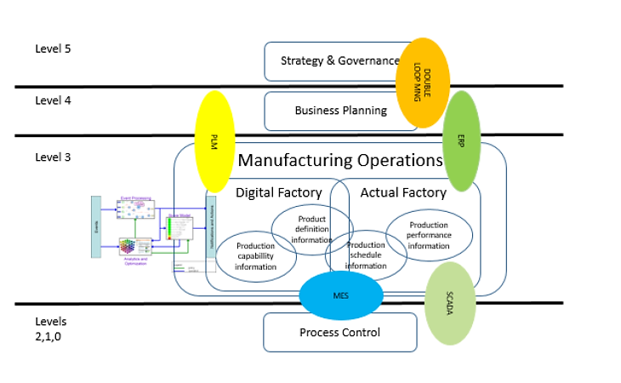
Business functions and the Smart Factory concept
Important
ERP – Enterprise Resource Planning
MES – Manufacturing Execution System
SCADA - Supervisory Control And Data System
DOUBLE LOOP MNG – Double Loop Management
PLM – Product Lifecycle Management

